Slide 1


PROJECT PRESENTATION IMAGE ANALYSIS AND PATTERN RECOGNITION
Charles Berger, Andrea Oliveri, Michael Chan – 04.06.2021
Notes:
1

Slide 2
SUMMARY
PIPELINE OF OUR PROCESSING
EXTRACTION OF THE FIGURES AND SUITS
TRAINING OF LINEAR SVM WITH FOURIER DESCRIPTOR
TRAINING OF CONVOLUTIONAL NETWORK
Charles Berger, Andrea Oliveri, Michael Chan
04.06.2021
1
Notes:
2

Slide 3
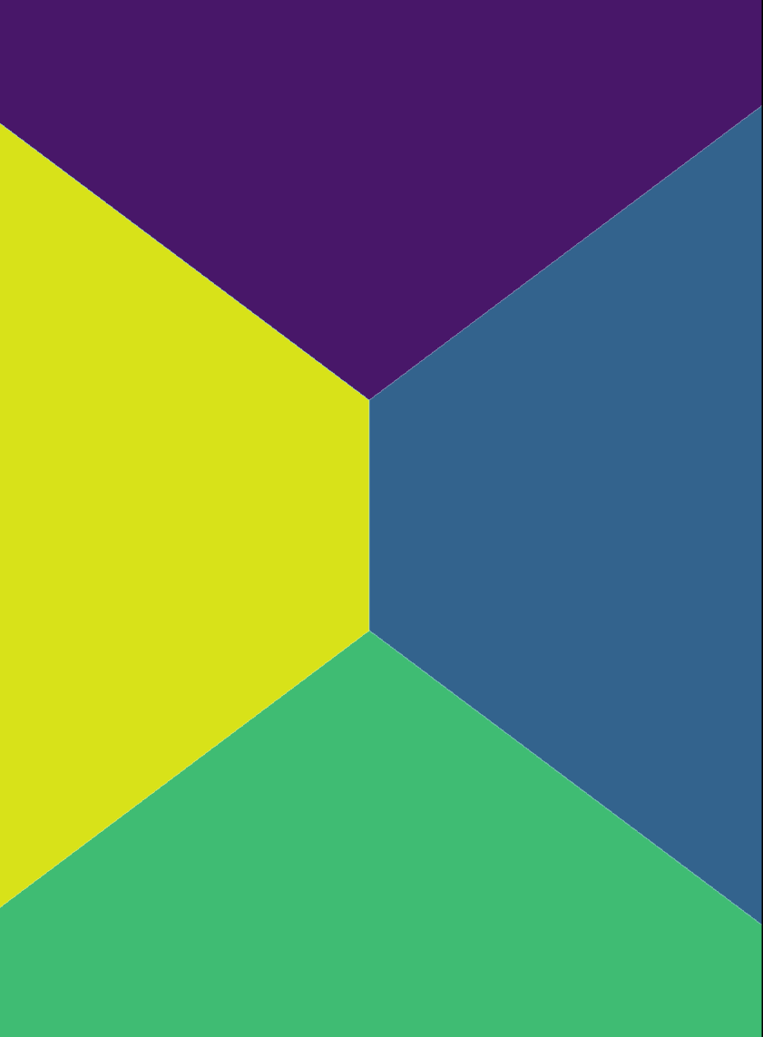
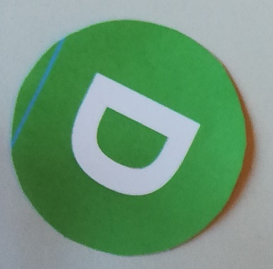
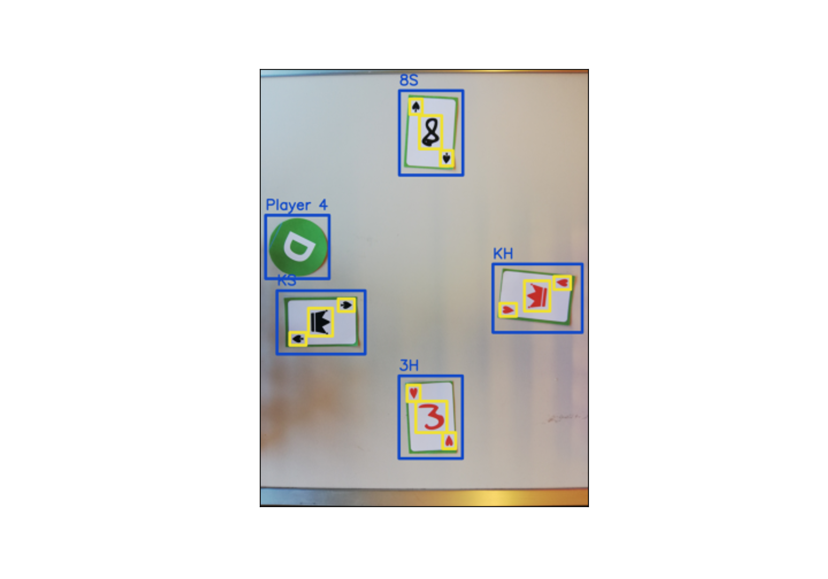



PIPELINE OF OUR PROCESSING
INTRODUCTION
Extraction
Fourier Descriptor with linear SVM
Convolutional network
Charles Berger, Andrea Oliveri, Michael Chan
04.06.2021
2
Notes:
3

Slide 4
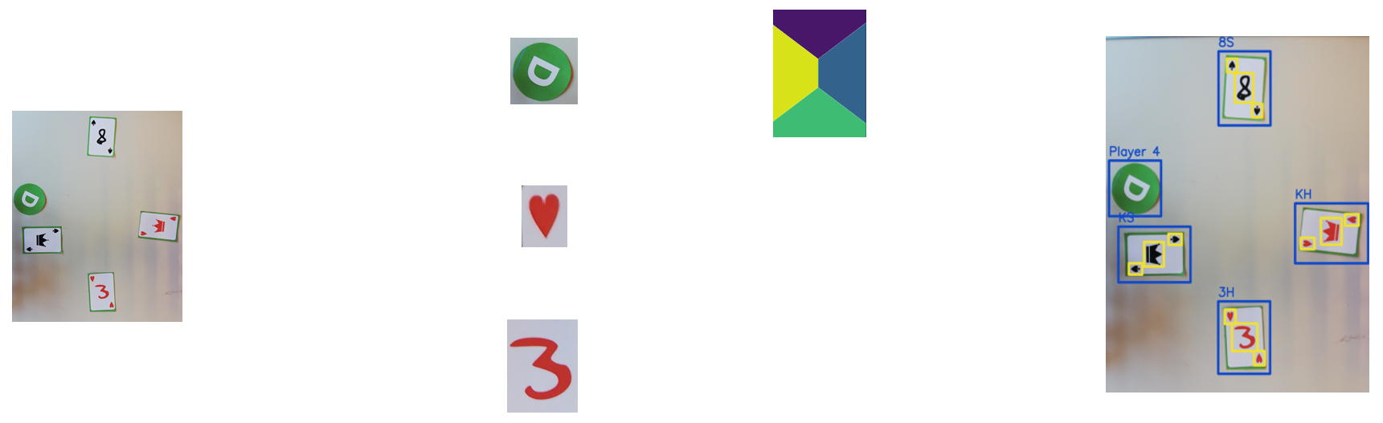

EXTRACTOR CLASS
SEGMENTATION
Extractor Class: receives an image and extracts from it :
The dealer position (and predicts which player is the dealer of the game) $→$ _extract_dealer(image)
The cards of each player $→$ _extract_cards(image, dealer)
The suits and figure from each card $→$ _extract_figures_suits(cards)
Charles Berger, Andrea Oliveri, Michael Chan
04.06.2021
3
Notes:
4

Slide 5

EXTRACT DEALER
SEGMENTATION
Compute a mask containing green pixels in the image
Find a circular object in mask $→$ Hough Gradient Method
Associate the dealer circle to a player
Return the position, the radius and the bounding box of the disk in the image and which player is the dealer
Charles Berger, Andrea Oliveri, Michael Chan
04.06.2021
4
Notes:
5

Slide 6
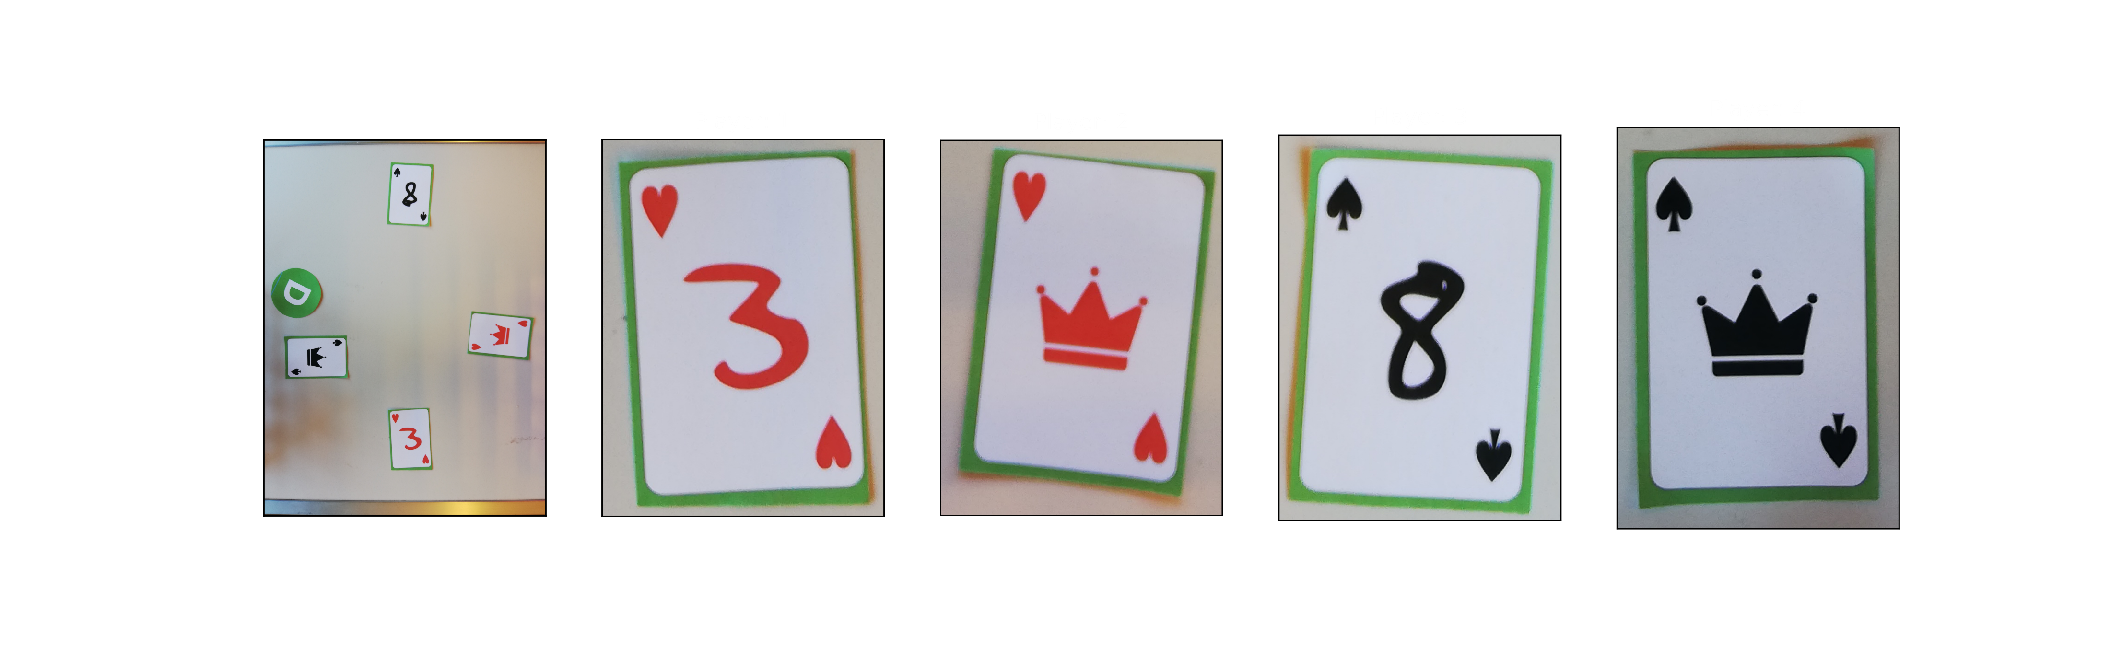
EXTRACT CARDS
SEGMENTATION
Apply a Canny edge detector on the image to get its gradient
Erase the dealer on the gradient and apply a gaussian blur to close the contours
Extract cards contours from the blurred gradient
Select only bounding boxes that have dimension suitable to cards
Suppress multiple detections of same card (using Non-Maximum-Suppression)
Associate cards with player and rotate them by multiples of 90°
Return cards image and bounding boxes with their associated player indicated
Charles Berger, Andrea Oliveri, Michael Chan
04.06.2021
5
Notes:
6

Slide 7
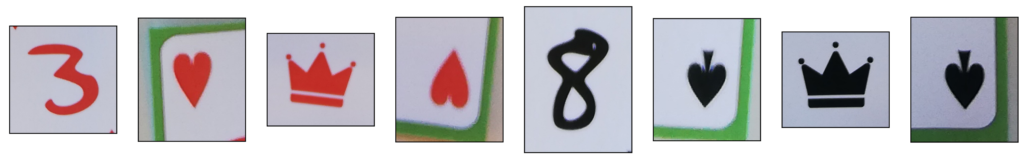
EXTRACT FIGURE AND SUITS
SEGMENTATION
For each cards, extract red and black pixels mask and only keep the one with the largest number of pixels
Apply a median blur on the mask to conserve contours and reduce noise
Assign labels to connected components in the mask
For each label, compute bounding box, centroids and the distance between the centroids and the origin (top-left) of image
Take the components on top left and bottom right to isolate the suits. All other components which have a distance from the origin between a chosen minimum and maximum compose the figure
Return both figure and suits extracted with their images and bounding boxes
Charles Berger, Andrea Oliveri, Michael Chan
04.06.2021
6
Notes:
7

Slide 8
TRAINING OF LINEAR SVM with FOURIER DESCRIPTOR
SUITS CLASSIFICATION
For each labelled game and round, we extract the suits
For each suit images collected, we create a mask containing only pixels of the appropriate color
We only keep the largest connected component in terms of area
For each image, we compute the Fourier Descriptor of the largest object and use the ground truth to get the suits label
Fourier Descriptors are made invariant to rotation, translation and scaling, and only the first few are kept
A Linear SVM with L1 regularization is trained
To choose the optimal parameters for the number of Fourier Coefficients to keep, and the classifier to use we performed a 5-folds cross-validation on our training set with 5 repeats, which yielded:
45 Fourier coefficients
L1 regularization (regularization parameter: 0.9) weights matrix is sparse
Linear SVM (no kernel nor more complex classifier)
Charles Berger, Andrea Oliveri, Michael Chan
04.06.2021
7
Notes:
8

Slide 9
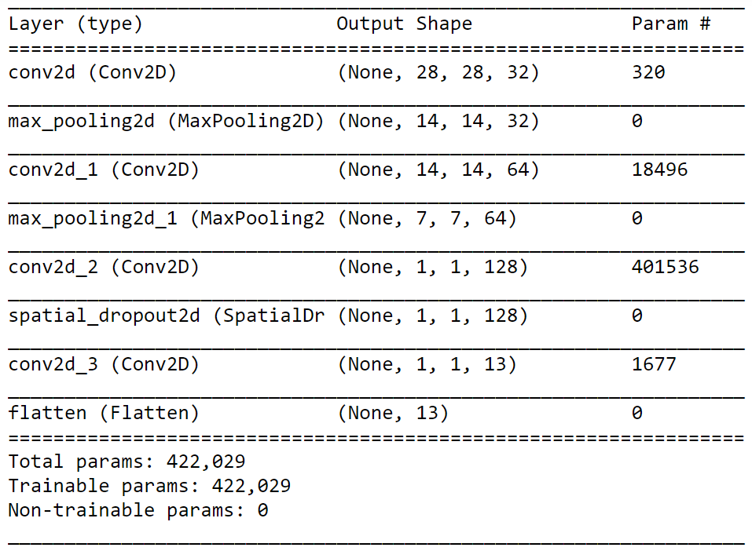

TRAINING OF CONVOLUTIONAL NETWORK
FIGURES CLASSIFICATION
All layers are ReLU activated (except the output layer $→$ Softmax activation)
Input images have resolution $28×28$
Neural network trained on digits from MNIST and one sample for each figure (King, Queen, Jack)
Heavy data augmentation performed:
Random Rotation between -30° and +30°
Random Scaling
Random Translation
Random Vertical Flip (King, Queen, Jack only)
In each batch, same number of samples of each class is present to deal with large class imbalance in training set
Charles Berger, Andrea Oliveri, Michael Chan
04.06.2021
8
Notes:
9

Slide 10
IMPROVEMENTS
ADDITIONAL
Make two different classifiers for the suits: one for the red-colored ones and one for the black-colored ones
Voting or Bagging Classifier using Linear SVM to predict Suits
Dealer is associated to player based on distance between the circle and the center of the image edges, whereas we could have used the distance from the center of each player’s card instead
The extraction step is too specific (we try to isolate suits and figure properly before even predicting). This causes a lot of parameters to be fine-tuned manually. An alternative could have been something which predicts on the whole image and keeps only the most probable predictions, for instance using a Fully Convolutional Network
Making a red/black mask for suits and figures is subject to changes in brightness and sometimes leads to uncomplete shapes as well as false positives. An alternative could be computing the edges and flood-filling
Charles Berger, Andrea Oliveri, Michael Chan
04.06.2021
9
Notes:
10

